Slide 1
Shipowner’s liability
Professor Erik Røsæg
Nordisk institutt for sjørett
erik.rosag@jus.uio.no
folk.uio.no/erikro

Slide 2
The owners
“Reder”
Owners
Owner pro hac vice
Different kinds of companies
Limited company
Partnership
Limited partnership
Other organizations
Joint ventures
Management

Slide 3
Different helpers
Agents
Stevedores
Manager
Pilots and tugs
Shipyards
Fire department and other public services

Slide 4
Characteristics of torts law
Basis of liability
Causation
Loss
Mitigation
Insurance

Slide 5
Diffferent kinds of claims
Contractual and extra-contractual
Personal injuries
Collision and other property damage
Consequential losses
Loss not in connection with personal injuries or property damage
Pure economic loss
Pure environmental damage

Slide 6
Negligence
Idea
Risk or blame?
Cases
Rt. 2011.1225 Sunna (which is a cargo damage case)

Slide 7
Strict liability
Ideas
Emergency, Torts Act s. 1-4
Technical failure
ND 1921.401 Neptun
ND 1952.320 Sokrates
Imperfect arrangement
Polluter pays. Pollution Act, 1981, s. 55
Cases
ND 1969.389 Ladogales
ND 1973.348 Uthaug

Slide 8
Vicaronous liability
Idea
Torts Act s. 2-1
NMC s. 151
Anonymous and cumulative errors
Pilots
Pilot Act, 1989, s. 24
ND 1963.34 Prince Charles
ND 1972.93 Stella Altair
Contributory negligence and state services
Rocknes LB-2009-163221
Corresponding rules in contracts
Cases
ND 1923.289 Irma-Mignon
ND 1984.122 Aeroplane in Bodø
ND 1914.159 Sardinia
ND 1973.343 Trygg

Slide 9
Collision liability
Collision convention
Ship to ship collisions
Three-ship collisions
Collision and pollution
Ship to shore collisions
ND 1921.401 Neptun
ND 1952.320 Sokrates
Both to blame collisions
Collision and insurance

Slide 10
Limitation
Policy
Claims subject to limitation
The special regime for clean-up costs
Claims not subject to limitation
Who has the right to limit
Amounts
Limitation and insurance
Procedure

Slide 11
New limits
The limit of liability for claims for loss of life or personal injury on ships not exceeding 2,000 gross tonnage is 3.02 million SDR (up from 2 million SDR).
For larger ships, the following additional amounts are used in calculating the limitation amount:
• For each ton from 2,001 to 30,000 tons, 1,208 SDR (up from 800 SDR) • For each ton from 30,001 to 70,000 tons, 906 SDR (up from 600 SDR) • For each ton in excess of 70,000, 604 SDR (up from 400 SDR).
The limit of liability for property claims for ships not exceeding 2,000 gross tonnage is 1.51 million SDR (up from 1 million SDR).
For larger ships, the following additional amounts are used in calculating the limitation amount: • For each ton from 2,001 to 30,000 tons, 604 SDR (up from 400 SDR) • For each ton from 30,001 to 70,000 tons, 453 SDR (up from 300 SDR) • For each ton in excess of 70,000 tons, 302 SDR (up from 200 SDR).

Slide 12
Personal injuries & property
SDR
2’ 30’ 70’ 100’
ton

Slide 13
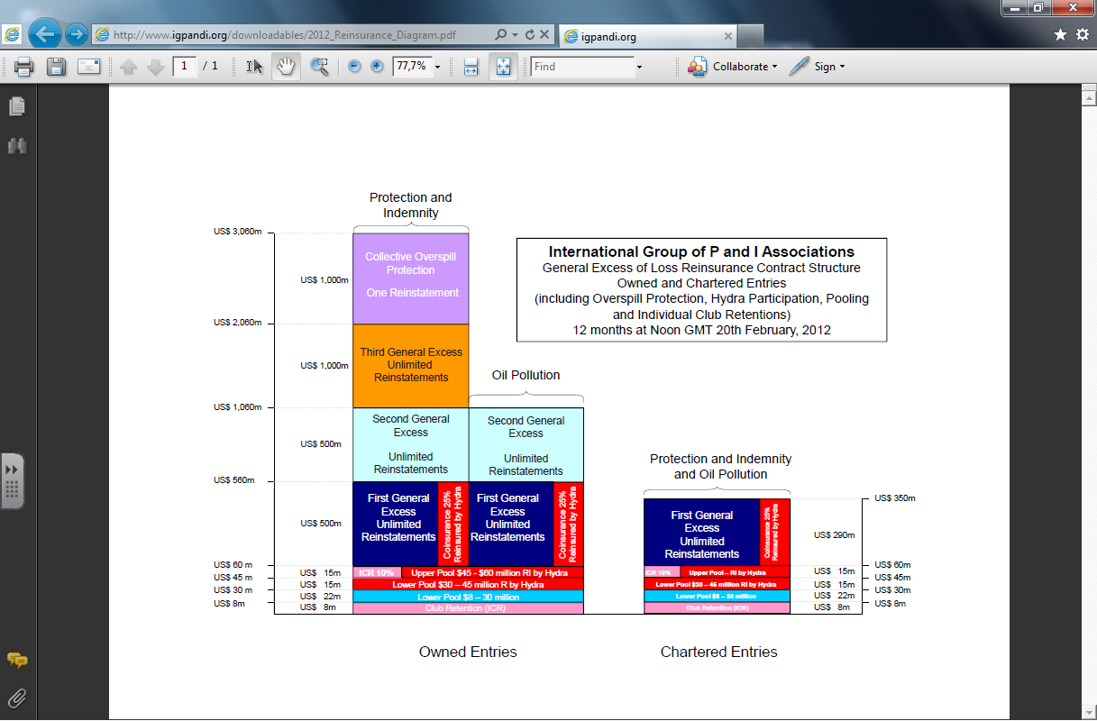

Slide 14
Limitation - some special issues
Privity
Single liability
Unit limitation
Mitigation
Subrogation
Owner’s costs

Slide 15
Recognition
ECJ C-39/02 Mærsk Olie & Gas A/S v Firma M. de Haan en W. de Boer
ND 2007.370 General Grot-Rowecki

